Slide 1


2024
Graduation Project
Content Filter
Dr Donia Gamal TA Lamis Hassan
FCIS-ASU
Computer Science
2023-2024

Slide 2

Team Members:
Andrew Adel Andrews
Veronica Emad William
Mehrael Ashraf Rahif
Monica Sameh Azer
Mariz Erian Ibrahim
Filobateer Essam Motamed

Slide 3










AGENDA
01
02
03
04
05
Introduction
System Architecture
Data Preparation
Preprocessing
Applied Models
06
07
08
09
10
Experiments & Results
Integration & Demo
Contribution
&
What’s Next
Time Plan
Summary & Conclusion

Slide 4
01
Introduction

Slide 5


Introduction
The internet is essential in everyday life but also contains harmful content, particularly with social media platforms being increasingly utilized for activities such as cyberbullying and hate speech.
Our motivation is to help create a safer environment for our vulnerable users that do not wish to be exposed to this type of inappropriate and violent content.
5

Slide 6


Objectives
The project aims to block cyberbullying, violence, and inappropriate content while allowing access to legitimate material.
Objectives include creating a background tool to filter text and images, using advanced machine learning for real-time application and addressing biases to ensure fair treatment of diverse perspectives.
6

Slide 7
02
System Architecture

Slide 8
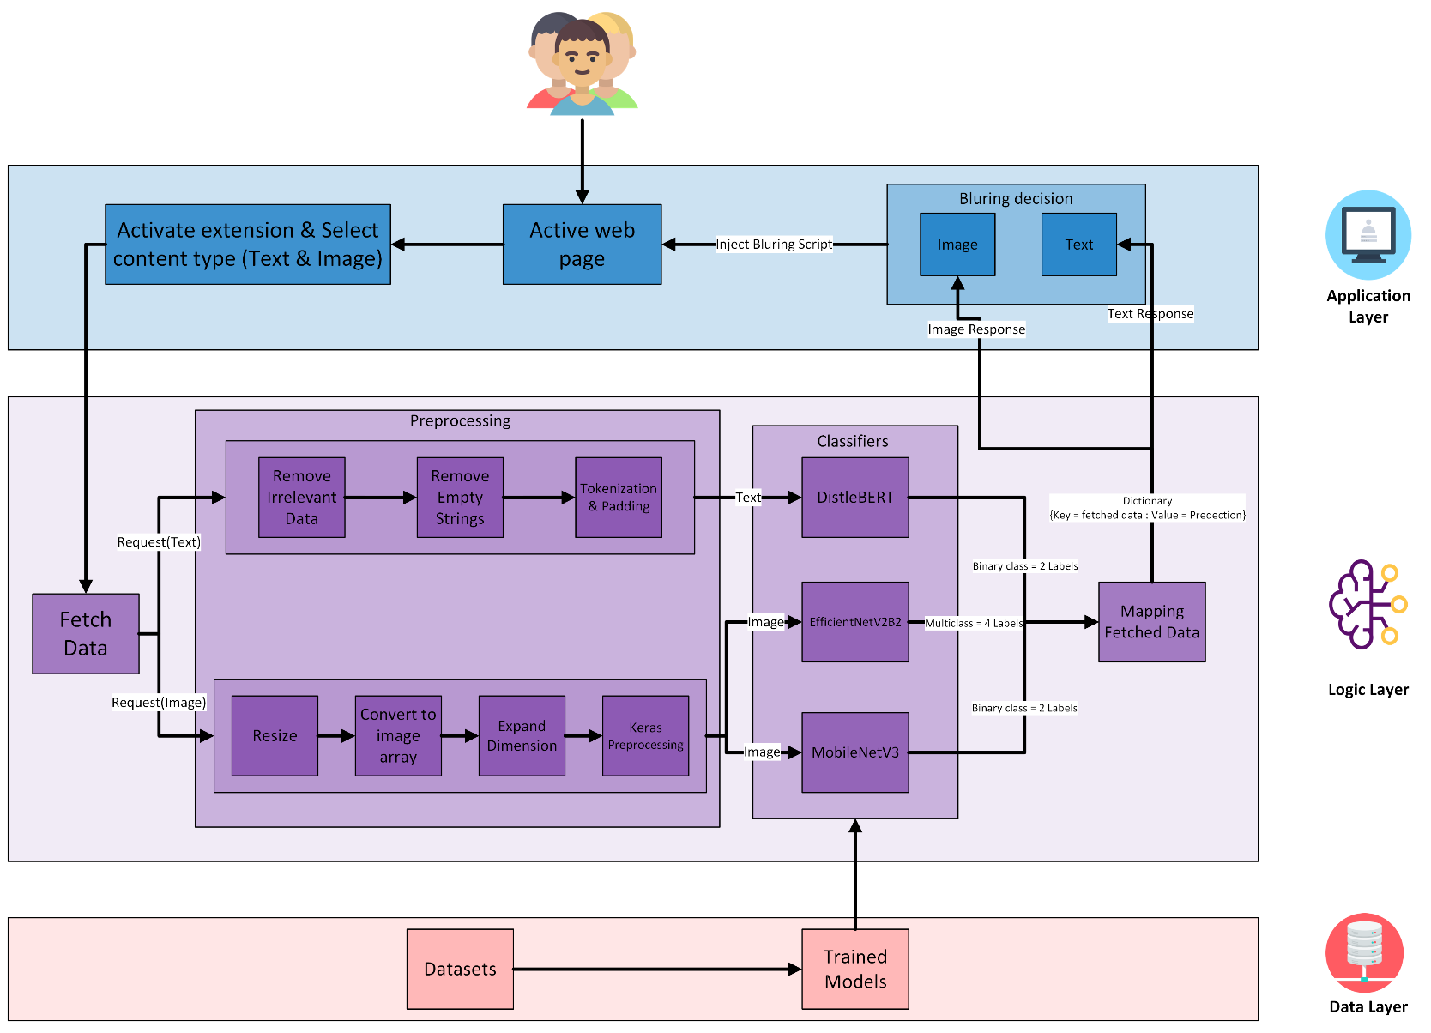
System Architecture
8

Slide 9
9

Slide 10
10

Slide 11
03
Data Preparation

Slide 12










Data Preparation
Text Binary Classification
Cyberbullying, hate speech, offensive…
Binary Image Classification
Violence & Non-violence
Multiclass Image Classification
Fire, accidents, damaged buildings & normal content
11

Slide 13


Binary Text Dataset
Our dataset is merged from 5 different datasets.
 | Datasets | Number of used records | Our Dataset
Inappropriate content | Cyberbullying dataset (aggression) | 14782 records | 167,051 records
 | Cyberbullying dataset (kaggle) | 2806 records
 | Tweets 1 | 20620 records
 | Toxic comments detection (Balanced) | 89363 records
 | Toxic comments detection (Classified comments) | 39480 records
Appropriate content | Cyberbullying dataset (aggression) | 101082 records | 165,669 records
 | Cyberbullying dataset (kaggle) | 5993 records
 | Tweets 1 | 4163 records
 | Toxic comments detection (Balanced) | 100513 records
 | Toxic comments detection (Classified comments) | 102425 records
12

Slide 14


Binary Text Dataset
Some datasets contained abbreviated slang words (lol, asap).
It also contained irrelevant content such as days, month, mentions, links, etc.
Most of the datasets were imbalanced.
Searched for a dataset that contains the original words of the slang words abbreviation.
Created a dictionary to replace them with their original words.
Ex: lol = laughing out loud, asap = as soon as possible.
Removed irrelevant content by
Creating a list of short and long version of each word.
Ex: Mon = Monday, Apr = April.
Used regular expression to remove these special characters .
Applied down sampling as a balancing technique.
13

Slide 15
Binary Image Dataset
Our dataset is merged from 2 different datasets.
 | Datasets | Number of used images | Our Dataset
Violence | Real Life Violence and Non-Violence Data | 5832 images | 11,674 images
 | Violence vs. Non-Violence: 11K Images Dataset | 5842 images
Non-Violence | Real Life Violence and Non-Violence Data | 5231 images | 10,462 images
 | Violence vs. Non-Violence: 11K Images Dataset | 5231 images
Both datasets were clean and devoid of significant issues. However, to enhance the deep learning model's performance, the decision was made to merge them
By combining the datasets, we capitalized on their strengths, resulting in a more diverse and effective training set
14

Slide 16
Multiclass Image Dataset
Our dataset is merged from 12 different datasets as each category is a combination of selected folders from 3-5 different datasets.
 | Dataset | Number of used images | Our Dataset
Fire | Cyclone Wildfire Flood Earthquake Database | 1077 images | 16,289 images
 | Forest Fire | 1022 images
 | The wildfire dataset V2 | 730 images
 | Forest_Fire_Smoke_and_Non_Fire_Image_Dataset | 10800 images
 | Wildfire_surveillance | 2580 images
Normal | The wildfire dataset V2 | 1157 images | 17,098 images
 | Fire Images Database | 3952 images
 | FOREST FIRE IMAGE DATASET | 7139 images
 | Wildfire_surveillance | 2580 images
15

Slide 17
Multiclass Dataset
 | Dataset | Number of used images | Our Dataset
Accidents | AIDER | 485 images | 16,011 images
 | Accident detection | 1675 images
 | Augmented image from (Traffic-Net dataset) | 13850 images
No enough data available.
Available datasets were very small.
Other datasets were video frames and doesn’t have scene varieties.
Extracted the good images from the available datasets.
Applied data augmentation on the extracted images to increase the size of the dataset.
Combined all the found images and the augmented ones into one dataset .
16

Slide 18
Multiclass Dataset
Multiclass Image Dataset
 | Dataset | Number of used images | Our Dataset
Damaged Buildings | RescueNet | 3595 images | 15,250 images
 | Cyclone Wildfire Flood Earthquake Database | 1350 images
 | AIDER | 511 images
 | Augmented Images from all previous datasets | 4164 images
 | Extracted buildings images from (Ukraine Images 2023) | 5630 images
No enough data available.
The images are resized to dimensions of 224x224 pixels as a preparatory step for utilization with pretrained models.
Applied data augmentation on the available good images to increase the size of the dataset
Combined all the found images and the augmented ones into one dataset
17

Slide 19
04
Preprocessing

Slide 20
Binary Text Preprocessing
We created a preprocessing pipeline to remove any irrelevant data from our dataset by removing numbers, symbols, and any symbols related specially for our dataset, like mentions and retweets.
01
Text Cleaning
02
Replaced any abbreviated words present with their elaborated versions to try and capture the full meaning behind the text.
Remove abbreviations
Splitting Data
Split the dataset into Train, Test and Validation.
03
DistilBERT Preprocessor
Used DistilBERT preprocessor with the preset data that contains a tokenizer and pads the text.
04
18

Slide 21
Binary Image Preprocessing
After splitting the data into Train, Test & Validation, we used keras internal module to generate our images form our dataset directory.
01
Splitting Data
The main benefit of using this approach is that it perform basic data augmentation like rotation, flipping, etc., which helps in improving model generalization, also it can work with the RGB Images.
02
Resize
We also resized our image to 224 x 224.
19

Slide 22
Multiclass Image Preprocessing
After splitting the data into Train, Test & Validation, we used keras ImageDataGenerator to generate our images while using efficientnet_v2 preprocessor as the preprocessing function.
01
Splitting Data
02
efficientnet_v2
The main benefit of using efficientnet_v2 is that it applies Normalization to the data and can work with the RGB Images.
Resize
03
We also resized our image to 224 x 224.
20
Notes:
efficientnet_v2 preprocessing unit performs standard preprocessing steps to make sure that all the input images are the same
Normalization involves scaling pixel values of the input image to a specific range.
resizing step ensures that all input images have consistent dimensions, which is often required by deep learning models

Slide 23
05
Applied Models

Slide 24
Applied Models
EfficientNetV2B2
The most lightweight model that ensures expedited and effective performance.
Multiclass Image Model
DistilBERT Transformer
Most efficient version of BERT to work with real-time data.
Binary Image Model
Text Model
MobileNetV3
This model seamlessly integrated into our system, delivering exceptional speed and efficiency.
21
Notes:
"DistilBERT, a distilled version of BERT: smaller, faster, cheaper and lighter"

Slide 25
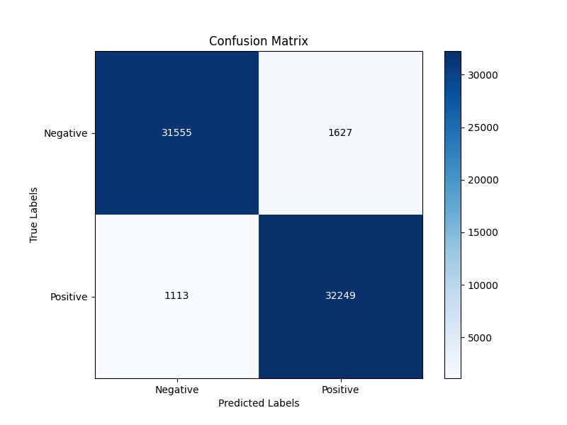
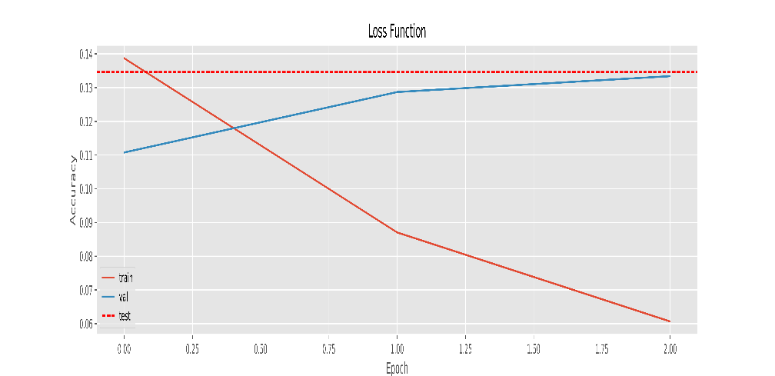
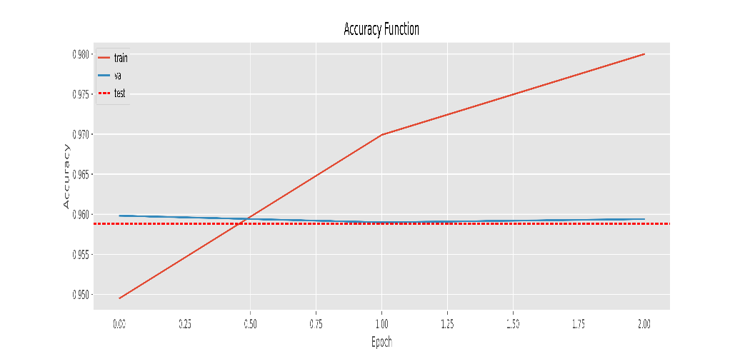
DistilBERT Transformer
22

Slide 26
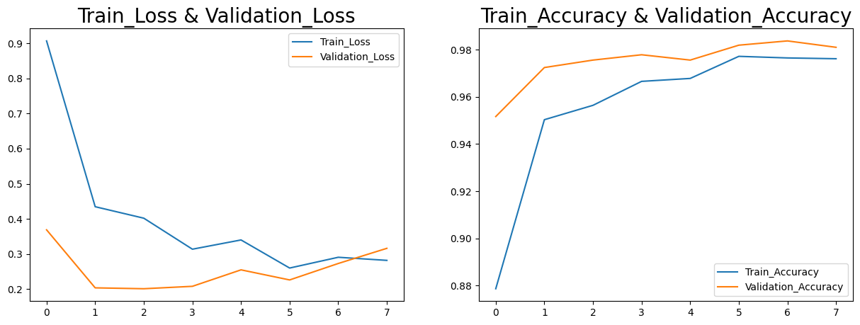
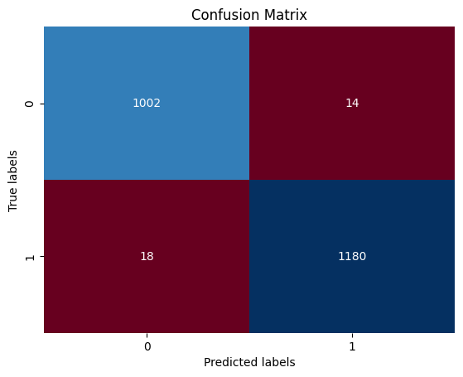
MobileNetV3
23

Slide 27
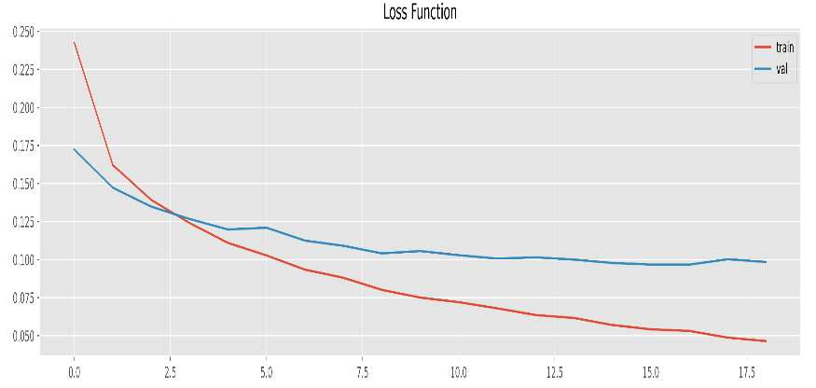
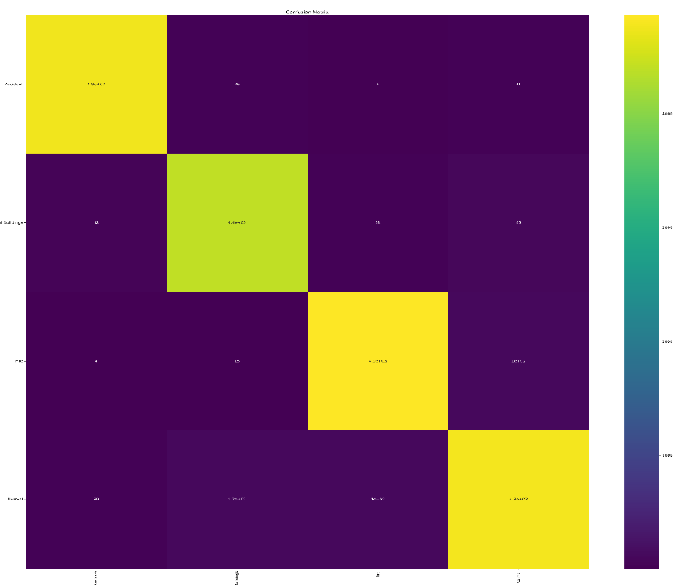
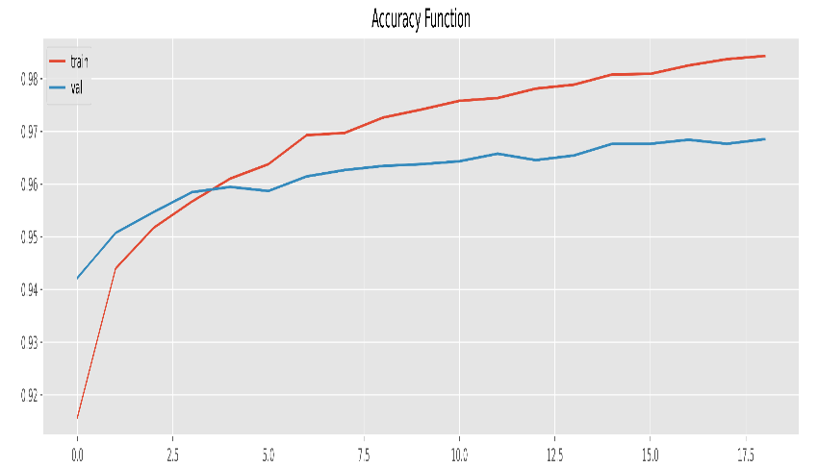
EfficientNetV2B2
Confusion Matrix
Accident
4.8e+03
26
6
41
4000
Damaged
Buildings
42
4.4e+03
32
86
3000
Actual
Fire
2000
4
15
4.9e+03
1e+02
1000
Normal
39
1.2e+02
1e+02
4.8e+03
Damaged
Buildings
Fire
Normal
Accident
Predicted
24

Slide 28
06
Experiments & Results

Slide 29
Experiments & Results
Accuracy
Exploring Diverse Model Approaches
0
25
50
75
100
Tried different traditional, modern and deep learning approaches.
Applied suitable preprocessing techniques foreach model to enhance it.
Applied hyperparameter tunning to improve models' performance.
Documented each experiment.
Text Transformers
Tested Models
Image Multiclass Model
Image Binary Model
25

Slide 30
Experiments (Binary Text Models)
Model | Number of epochs | Train Accuracy | Train Loss | Validation Accuracy | Validation Loss | Test Accuracy | Test Loss
RoBERTa | 3 | 97.9% | 0.055 | 96.97% | 0.1031 | 96.89% | 0.1022
DistilBERT | 3 | 98.4% | 0.045 | 96.78% | 0.1061 | 96.78% | 0.1095
BERT | 3 | 98.3% | 0.047 | 96.6% | 0.1092 | 96.63% | 0.1083
FNet | 4 | 98.7% | 0.037 | 96.46% | 0.11 | 96.45% | 0.11
26

Slide 31
Experiments (Binary Image Models)
Model | Number of epochs | Train Accuracy | Train Loss | Validation Accuracy | Validation Loss | Test Accuracy | Test Loss
ResNet50 | 40 | 99.48% | 0.0284 | 98.8% | 0.0504 | 98.8% | 0.0503
MobileNetV3 | 10 | 98.78% | 0.2812 | 98.87% | 0.9846 | 98.55% | 0.1699
EfficientNetB0 | 40 | 97.6% | 0.0671 | 97.34% | 0.0702 | 97.3% | 0.0702
VGG19 | 27 | 94.7% | 0.1451 | 94% | 0.1491 | 94.6% | 0.1413
DensNet121 | 40 | 91.6% | 0.2140 | 90% | 0.2664 | 91.9% | 0.2165
MobileNetV2 | 40 | 89.48% | 0.2528 | 89.75% | 0.2570 | 89.74% | 0.2569
Xception | 27 | 85.15% | 0.3617 | 78.8% | 0.4223 | 84.4% | 0.3422
AlexNet | 20 | 80% | 0.5149 | 79.7% | 0.6003 | 79.7% | 0.6002
NASNetLarge | 40 | 87.7% | 0.2935 | 78.9% | 0.4127 | 78.9% | 0.4126
InceptionV3 | 9 | 75.45% | 0.5812 | 65.13% | 0.8313 | 76% | 0.4843
27

Slide 32
We selected these models based on their efficiency and compact size, considering the trade-off among accuracy, performance, and efficiency within the constraints of our available resources.
Experiments (Multiclass Image Models)
Model | Number of epochs | Train Accuracy | Train Loss | Validation Accuracy | Validation Loss | Test Accuracy | Test Loss
ConvNeXtXLarge | 6 | 99% | 0.0184 | 98.69% | 0.0403 | 98.93% | 0.0364
ConvNeXtBase | 11 | 99.7% | 0.0136 | 97.9% | 0.683 | 98.1% | 0.0630
ResNet50 | 13 | 99.6% | 0.0187 | 96.9% | 0.1004 | 96.95% | 0.0992
EfficientNetV2B2 | 19 | 98% | 0.0531 | 96.7% | 0.0968 | 96.85% | 0.0935
DenseNet201 | 10 | 99.4% | 0.0174 | 96.9% | 0.1231 | 96.7% | 0.1118
MobileNetV3Large | 6 | 99% | 0.0273 | 96% | 0.1271 | 95.9% | 0.1098
Xception | 25 | 97.69% | 0.1305 | 94.2% | 0.1859 | 94.3% | 0.2842
NASNetMobile | 8 | 97.57% | 0.0674 | 93.79% | 0.2025 | 93.8% | 0.1804
Inception-ResNet-v2 | 8 | 96% | 0.0674 | 93.5% | 0.2025 | 93.58% | 0.1926
InceptionV3 | 11 | 97.65% | 0.0626 | 93.17% | 0.2308 | 93.26% | 0.211
VGG16 | 25 | 69.35% | 1302.27 | 75% | 2.5057 | 74.96% | 299.9
28
Notes:
ConveNeXtBase slower 40% than EfficientNet
Xlarge → best accuracy → Largest model 1.5GB
Base → lightweighted 350MB → but slower in the real time app
Efficient → Lightest model 35MB → Fastest one in real time app (faster than Base with 40%)
VGG → Worst accuracy → better with binary classifications

Slide 33
07
Integration & Demo

Slide 34






Tools
Tensorflow
Kaggle Notebooks
Keras
Python
Flask
HTML, CSS, JS
29

Slide 35
Integrating Models with the Application
1
Create Chrome extension with scripting and Active tab permissions
2
Fetch data from current active tab & send it to the backend
3
Create a Flask project (our backend)
4
Load models in the flask project
5
Create function (route) that will receive data from the extension in the backend
30
Notes:
Create Chrome extension with scripting and Active tab permissions
active tab permission => To know the current tab
Scripting permission => To inject script on some tab (active tab)

Slide 36
Integrating Models with the Application
6
Apply preprocessing steps needed to the received data
7
Get predictions from loaded models
8
Send this predictions in a dictionary to the extension
9
Receive predictions dictionary (one dict. for each model)
10
Act based on the predictions dictionary values (Blur)
31
Notes:
Send this predictions in a dictionary to the extension
Key=> fetched data item
value=> Prediction

Slide 37

Extension
32

Slide 38
Challenge
Capturing data from the website and sending it to the back-end model for classification, This process required injecting a script into the active tab of the browser
Leveraged Chrome Extension APIs:
Employed a combination of chrome extension APIs.
One API facilitated retrieving information about the active tab, while the other enabled injecting our script into the active tab’s content.
Obtained Active Tab Details:
Used an appropriate API to acquire data about the currently active tab.
This data included the tab’s ID or handle, which is crucial for script injection.
Injected Our Script:
Armed with the active tab’s ID, we employed another Chrome extension API to inject our custom script directly into the content of the active tab.
This API allows us to execute JavaScript code within the context of the active tab.
33

Slide 39
Demo

Slide 40
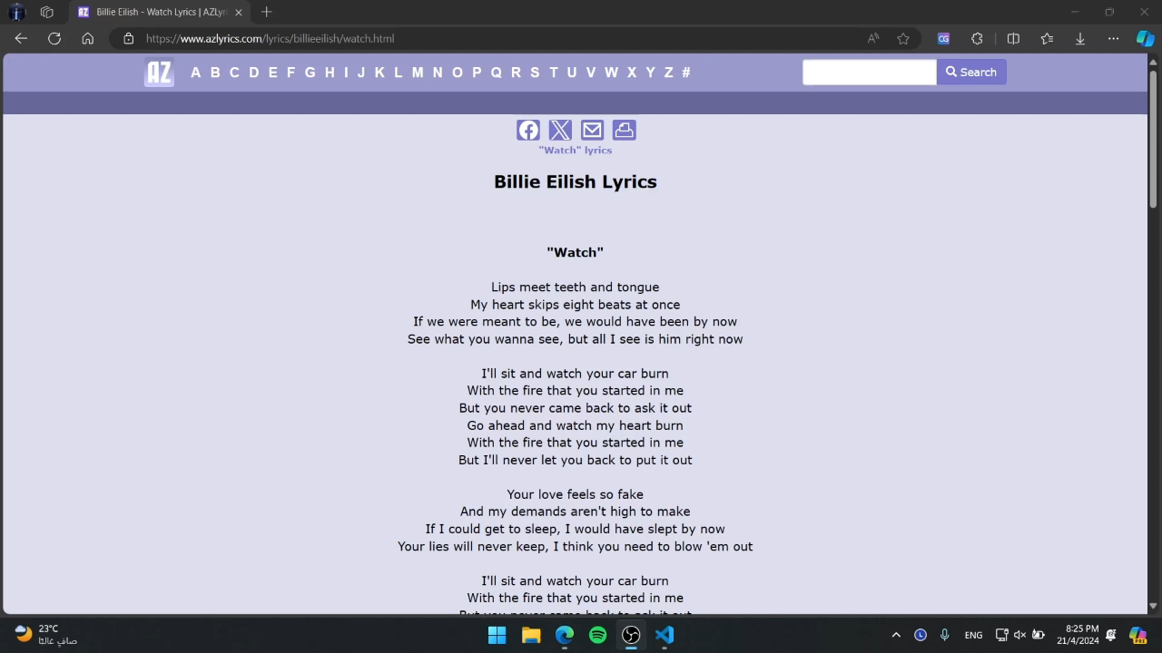
34

Slide 41
8.1
Contributions

Slide 42



Contributions
Enhanced Diversity
Advanced Data Augmentation
Merging datasets expanded diversity and addressed data imbalance.
Implemented innovative data augmentation techniques to enhance model training and boost performance.
Improved Generalization
Future-proofing
Broadened examples improved model generalization.
Ensured competitiveness and adaptability to evolving challenges.
35

Slide 43



Contributions
Expanded Scope
Real-world Impact
New labels enriched insights and facilitated novel use cases.
Reliable outcomes with improved accuracy for practical applications.
Respect User Preferences
Cutting-edge Techniques
Give the user the option to select the type of media the user wants to filter.
Latest models led to significant performance improvements.
36

Slide 44
8.2
What’s next?

Slide 45



What’s next?
Adding new feature
Empower users with the freedom to choose the content they wish to view, without being compelled to view or hide specific types of content.
Improve performance
Enhance the accuracy of models while simultaneously reducing the latency of their predictions.
Deploying the models
Deploy the models in the cloud to leverage the benefits of cloud computing infrastructure and services.
37
Notes:
→ newada7 point adding new feature de fe el shar7

Slide 46
09
Time Plan

Slide 47
Time Plan
Seminar 1
Seminar 2
Seminar 3
29 Nov
24 Apr
 | Nov | Dec | Jan | Feb | Mar | Apr | May | Jun | Jul
Survey & Learning
Requirement Specification
Project Analysis
Project Design
Implementation
Project Testing
Maintenance
Enhancement
Documentation
38

Slide 48
10
Summary & Conclusion

Slide 49




Summary & Conclusion
Create a safer environment for our vulnerable users that do not wish to be exposed to this type of inappropriate and violent content.
Performed sequence classification instead of token classification to be able to understand hidden meanings form inappropriate text.
Goal
We've implemented two methods: binary and multiclass image classification. Our filtration combines the parallel predictions of both models to determine the outcome.
Text Classification
Image Classification
Achievement
Our extension operates universally across all web pages, enhancing the browsing experience by filtering out inappropriate content from online sources, not just limited to social media platforms.
39

Slide 50

THANK YOU!

Slide 51
Challenges (Text Models)
NLP Transformers are large and require significant computational resources for training and inference.
They also take a huge amount of time to train on the given dataset.
Limited number of NLP Classification Transformers.
No recent published papers that discuss text classification using Transformers.
Used Kaggle Notebooks to make use of the available resources provided by Kaggle.
Tried different Classifiers to choose the most suitable one for our application.
32

Slide 52
At the conclusion of our evaluation, we selected these models based on their efficiency and compact size, considering the trade-off among accuracy, performance, and efficiency within the constraints of our available resources.
Challenges
All models are large and require significant computational resources for training and inference.
Training the models took huge amount of time to train on the given dataset.
Limited number of NLP Classification Transformers.
No recent published papers that uses the modern models to filter our categories.
Used Kaggle Notebooks to make use of the available resources provided by Kaggle.
Tried multiple models while applying hyperparameter tunning to choose the most suitable one for our application.
32

Slide 53
Challenges (1)
Saving and loading the models for backend use.
Initially, we saved our models using Keras with the extension “.h5”.
However, some models failed to load correctly, causing inconsistencies in our application’s performance.
Transitioned to using TensorFlow functions.
This change significantly improved the reliability of our model loading process, ensuring that our extension project could consistently deliver the expected results.
38

Slide 54
Challenges (2)
Mismatched Dependencies and Version Conflicts.
These conflicts hindered the seamless integration of our models, leading to unexpected errors and inconsistencies in our application.
The problem was that different models required different versions of the same dependencies, which led to conflicts during runtime.
Identified the specific versions of dependencies required by each model.
Ensuring that these versions were compatible with our back-end infrastructure.
Updating or downgrading versions as necessary to resolve conflicts.
39

Slide 55
Challenges (4)
Large Model Burden
Some of these models exceeded 1 GB in size, posing significant challenges:
Performance: Large models require substantial computational resources to execute. This could lead to sluggish performance in the context of a Chrome extension, potentially impacting user experience.
Deployment Constraints: Distributing and storing a 1GB+ model can be cumbersome. Limited storage capacities in extensions and bandwidth limitations during installation could create deployment obstacles.
Strategic Model Selection: Re-evaluated the available models, prioritizing those with a smaller footprint while still achieving satisfactory performance for our extension's specific tasks. This might involve exploring pre-trained models designed for on-device execution or researching techniques for model compression.
41

